Slide 1
COMPUTER ORGANIZATION AND ARCHITECTURE
Dr. Rizwan Khan
Head – Department of Computer Science and Engineering
(An NBA Accredited Program)
ABES Institute of Technology, Ghaziabad

Slide 2


Chapter 12 Problems

Slide 3



Slide 4


Slide 5

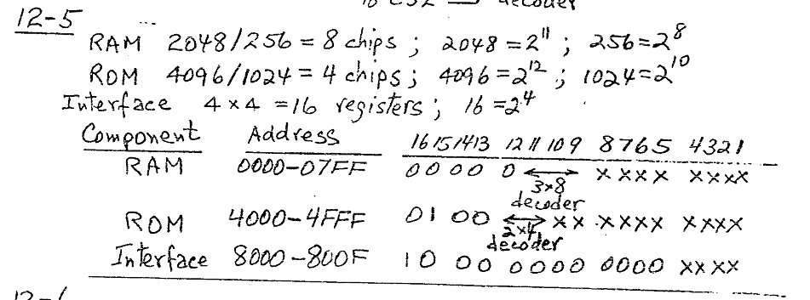

Slide 6

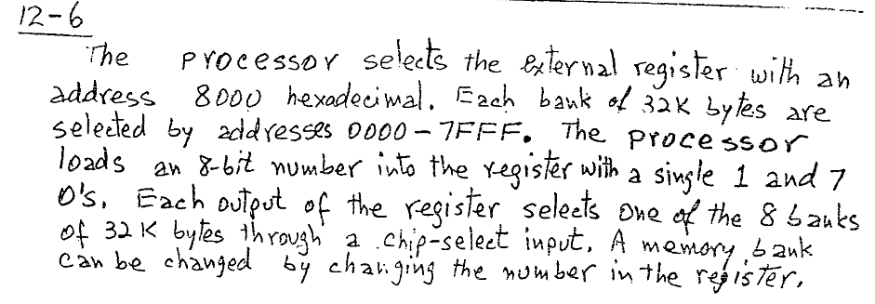

Slide 7



Slide 8


Slide 9


